Slide 1
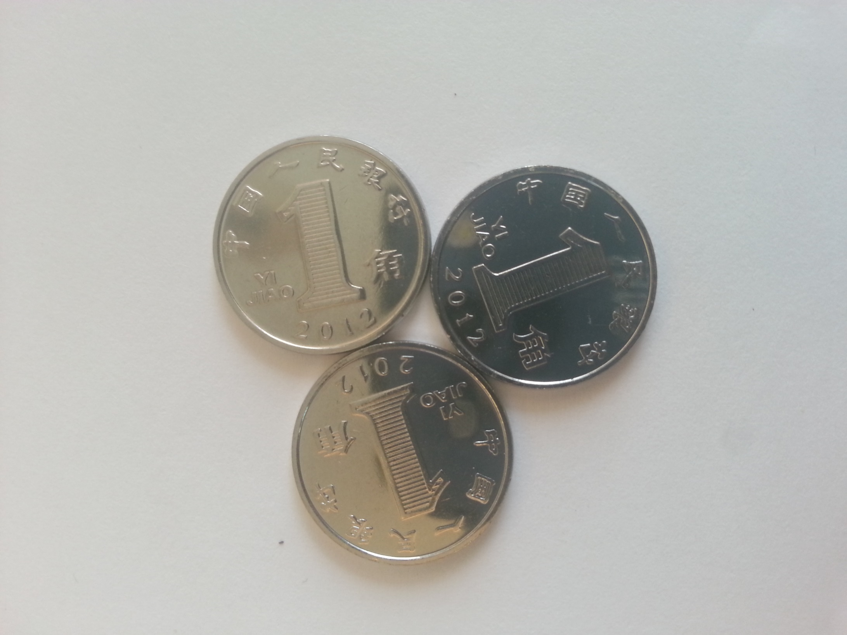
Tell me something mathematical about the picture?

Slide 2
If these coins were surrounded by a triangle:
~ what would the triangle be (prove your answer)?
~ what area of the triangle would not be covered by the coins?
~ write the ratio of the area of the three coins to the area of the triangle as 1:n.

Slide 3
If these coins were surrounded by a triangle:
~ what has the greatest perimeter the coins or triangle (prove it)?
~ write the ratio of the triangle perimeter to the perimeter of the coins as 1:n.

Slide 4
If there were enough coins to make the next triangle how many coins would there be?
Is there a general formula for the perimeter & area of the triangle formed around increasing number of coins that make the triangle?

Slide 5
What is the area in the middle of the coins?

Slide 6
Some ideas to pursue
Value of the coins
Exchange Rates
Estimate the actual size of the coins
Estimate the weight of the coins
Do the three coins have rotational symmetry? If not how could they be arranged to have rotational symmetry?
What area of the coin does the 1 on the coin take up?
Talk about triangle numbers. What is the formula for triangle numbers?

