Slide 1
TANGRAMS
A task for Chinese New Year for years 7, 8, 9, & 10.
http://games.ztor.com/tang/

Slide 2
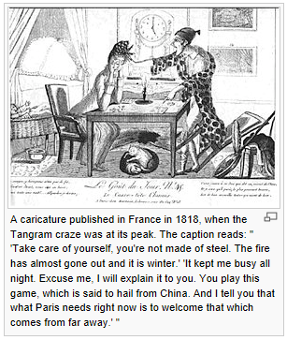
A Little History
The tangram (Chinese: 七巧板; pinyin: qī qiǎo bǎn; literally "seven boards of skill") is a dissection puzzle consisting of seven flat shapes, called tans, which are put together to form [many different]shapes.
The objective of the puzzle is to form a specific shape (given only an outline or silhouette) using all seven pieces, which may not overlap.
It is reputed to have been invented in China during the Song Dynasty,^{[1]} and then carried over to Europe by trading ships in the early 19th century.
It became very popular in Europe for a time then, and then again during World War I. It is one of the most popular dissection puzzles in the world.^{[2][3]}
A Chinese psychologist has termed the tangram "the earliest psychological test in the world", albeit one made for entertainment rather than analysis.^{[1]}

Slide 3
Year 7
Fractions, percentages, decimals, ratio & puzzles to solve.
http://games.ztor.com/tang/

Slide 4
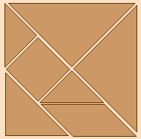
Recreate the shape.
What % of the total area is each shape?
What fraction of the total area is each shape?
What decimal of the total area is each shape?
Label each shape A to G. What is the ratio of each shape with respect to each other?
Cut out the tangram and try to make the shapes on the next slide.

Slide 5
Once you have created the shape sketch it into your book.
http://games.ztor.com/tang/ answers

Slide 6
Year 8
Properties of shapes, perimeter, area & puzzles to solve.
http://games.ztor.com/tang/

Slide 7
Recreate the shape.
What is the perimeter of the shape?
What is the area of the shape?
Name each shape and list all its properties, including angles and symmerty.
Find the perimeter of each shape.
Find the area of each shape.
Cut out the tangram and try to make the shapes on the next slide.

Slide 8
After each shape is completed draw it into your book and work out the perimeter and area of each shape.
http://games.ztor.com/tang/ answers

Slide 9
Year 9
Transformations &/or angles, a little bit of probability & puzzles to solve.
http://games.ztor.com/tang/

Slide 10
Recreate the shape. Can you do it just by folding and not measuring?
If you were to play pin the maths teacher to the square on the right what would be the probability of pining the teacher on each shape?
P(A) = P(B) =
P(C) = P(D) =
P(E) = P(F) =
P(G) = P(not C) =
P(triangle) = P(a shape with a right angle) =
Given the pin is in a triangle what is the probability it is in a small triangle?
Cut out the tangram and make one of the shapes on the next slide.
A
E
F
B
G
D
C

Slide 11
After you have created one of the shapes draw it into your book on a set of axes. Then try to work out the transformations that are required to go from E to G, E to A, A to B, E & G to make F. Make up some of your own.
See next slide.
http://games.ztor.com/tang/ answers

Slide 12
Draw each axis first and then when drawing your shape try to make the shortest side of the smallest piece of the tangram 3 units (squares) long.
Work out the transformation(s) that are required to go from
E to G,
E to A,
A to B,
E & G to make F.
Make up some of your own.
Y
F
G
D
B
A
C
E
X

Slide 13
Year 10
Puzzles to solve, sets and equations
http://games.ztor.com/tang/

Slide 14
Recreate the shape.
P is the set of shapes with a right angle = {____________________}.
Q is the set of triangles = {__________________}.
R is the set of quadrilaterals = {______________}.
Draw a Venn Diagram to represent the shapes A to G.
Find
n(P) = n(Q n R) =
N(P n C) = What is Q with respect to P?
Cut out the tangram and make one of the shapes on the next slide.
A
E
F
B
G
D
C

Slide 15
After you have created one of the shapes draw it into your book on a set of axes. Then try to work out the equation of the lines that make up the edges of the shape.
See next slide.

Slide 16
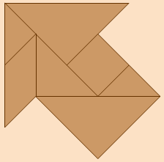
Draw your axis first, draw your shape wherever you like and then put the numbers on the axes.
Find the equations of the lines that make up the outline of the shape.
Y
X
Too easy! Then try one of the shapes on the next slide

Slide 17
After you have created one of the shapes draw it into your book on a set of axes. Then try to work out the equation of the lines that make up the edges of the shape.
See next slide.
http://games.ztor.com/tang/ answers

Slide 18
Some information about the shapes

Slide 19
Choosing a unit of measurement so that the seven pieces can be assembled to form a square of side one unit and having area one square unit, the seven pieces are:
2 large right triangles (hypotenuse , sides , area )
1 medium right triangle (hypotenuse , sides , area )
2 small right triangle (hypotenuse , sides , area )
1 square (sides , area )
1 parallelogram (sides of and , area )
Of these seven pieces, the parallelogram is unique in that it has no reflection symmetry but only rotational symmetry, and so its mirror image can be obtained only by flipping it over. Thus, it is the only piece that may need to be flipped when forming certain shapes.
http://en.wikipedia.org/wiki/Tangram

Slide 20
Other Ideas

Slide 21
There are only 13 convex tangrams find all of them. This is one of them.
A convex shape is a polygon that if you were to draw a line from any 2 vertices it would go through the interior of the shape.
Which of these are convex and which of these are concave?
Answers next slide

Slide 22
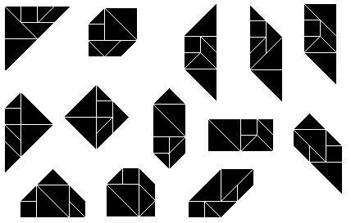
The 13 Convex Trangrams
http://en.wikipedia.org/wiki/Tangram

Slide 23
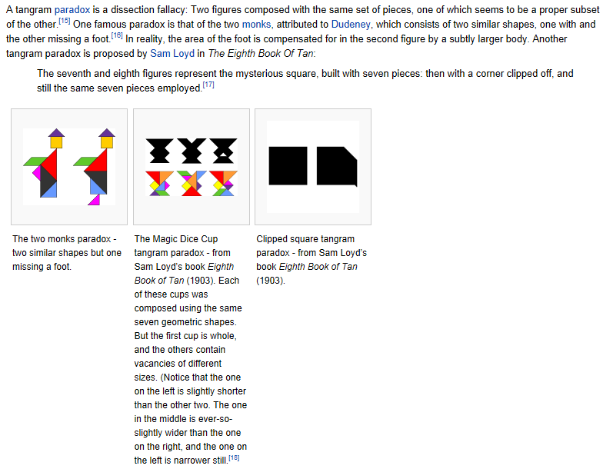
http://en.wikipedia.org/wiki/Tangram

