Slide 1
Some of these photos are on Geometer’s Sketch Pad which we will use to find the equation of the curves in the photos.

Slide 2
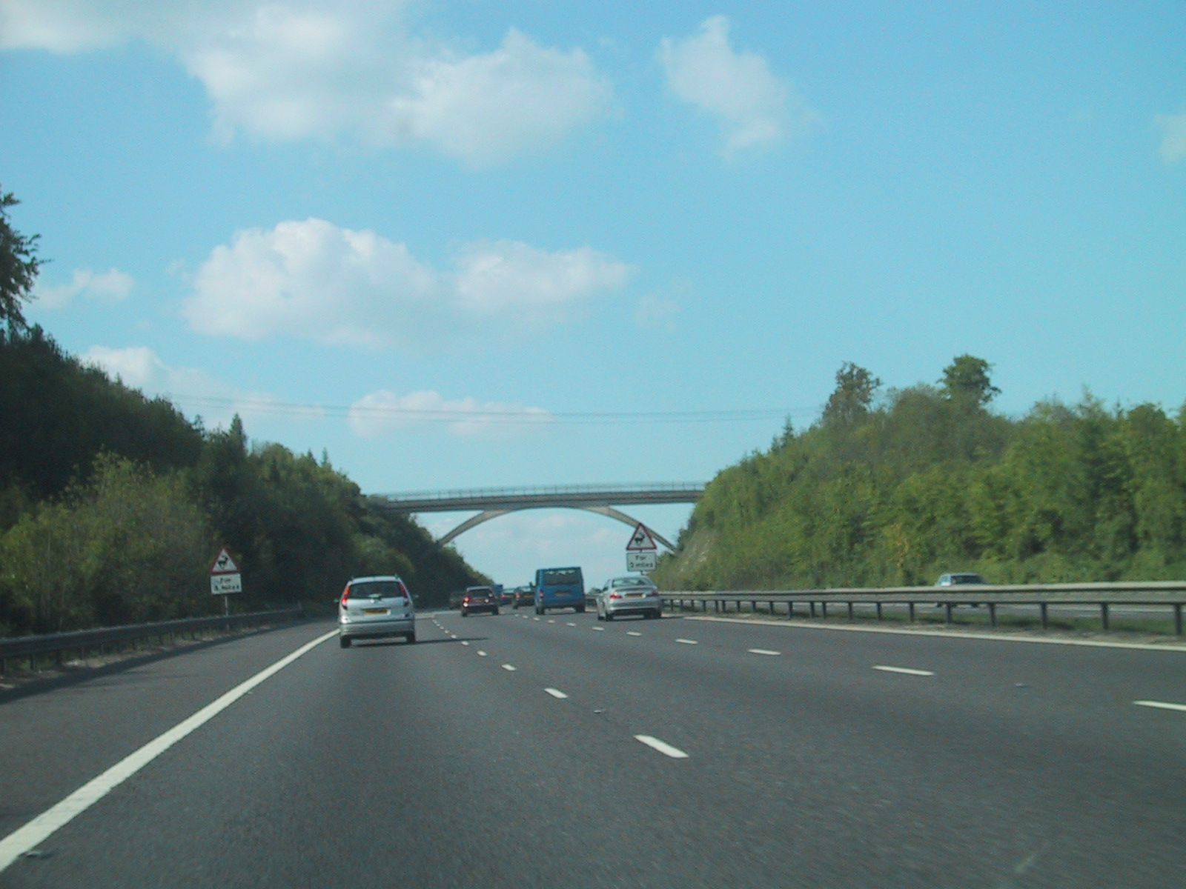
Bridge on the A3, UK

Slide 3
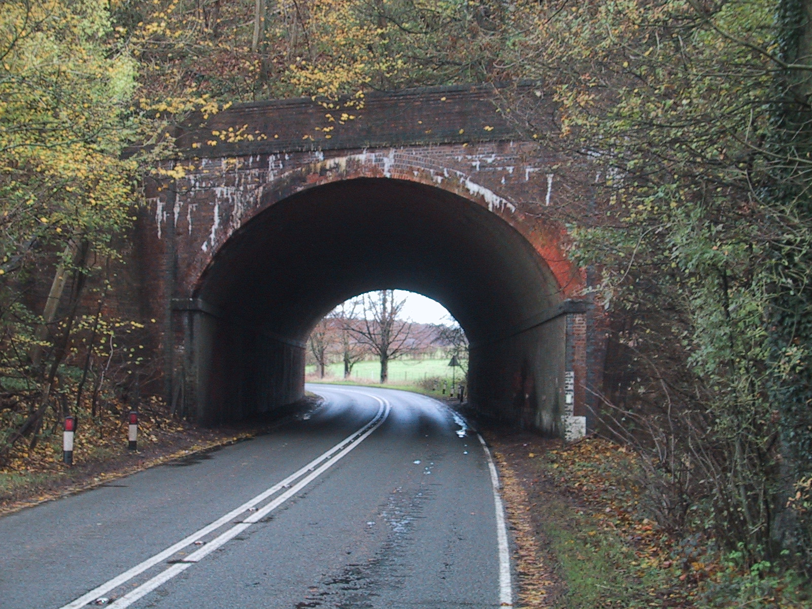
Bridge on a road to Winchester, UK

Slide 4
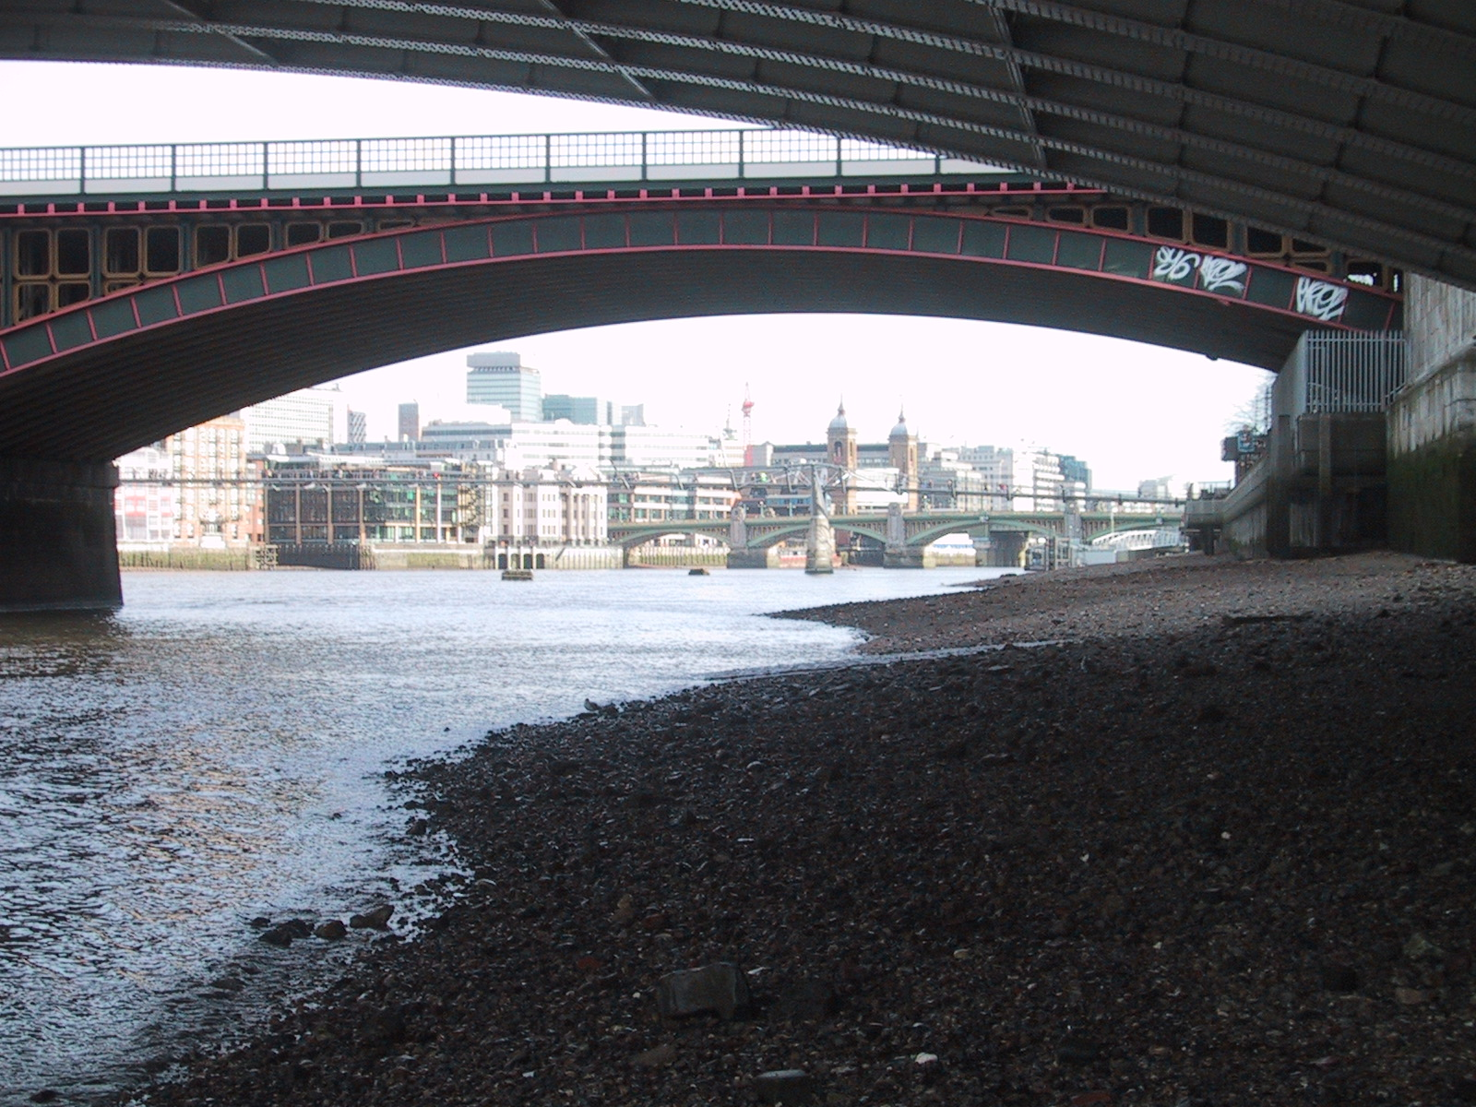
Bridge over the River Thames, London, UK

Slide 5
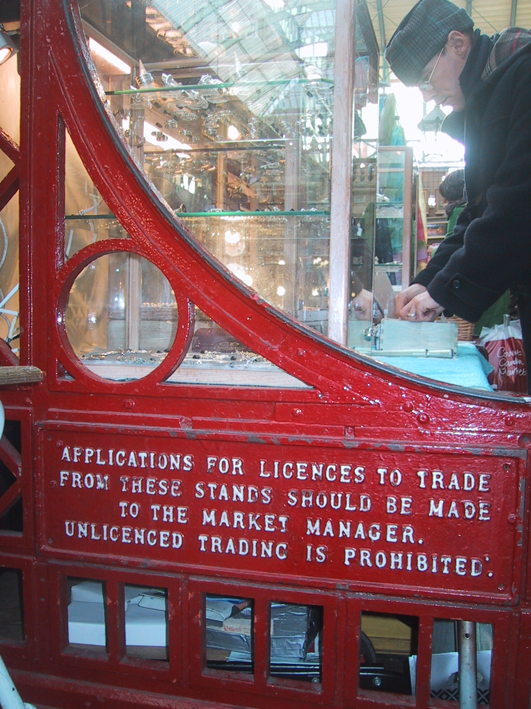
Covent Garden Market Stall Stand, London, UK

Slide 6
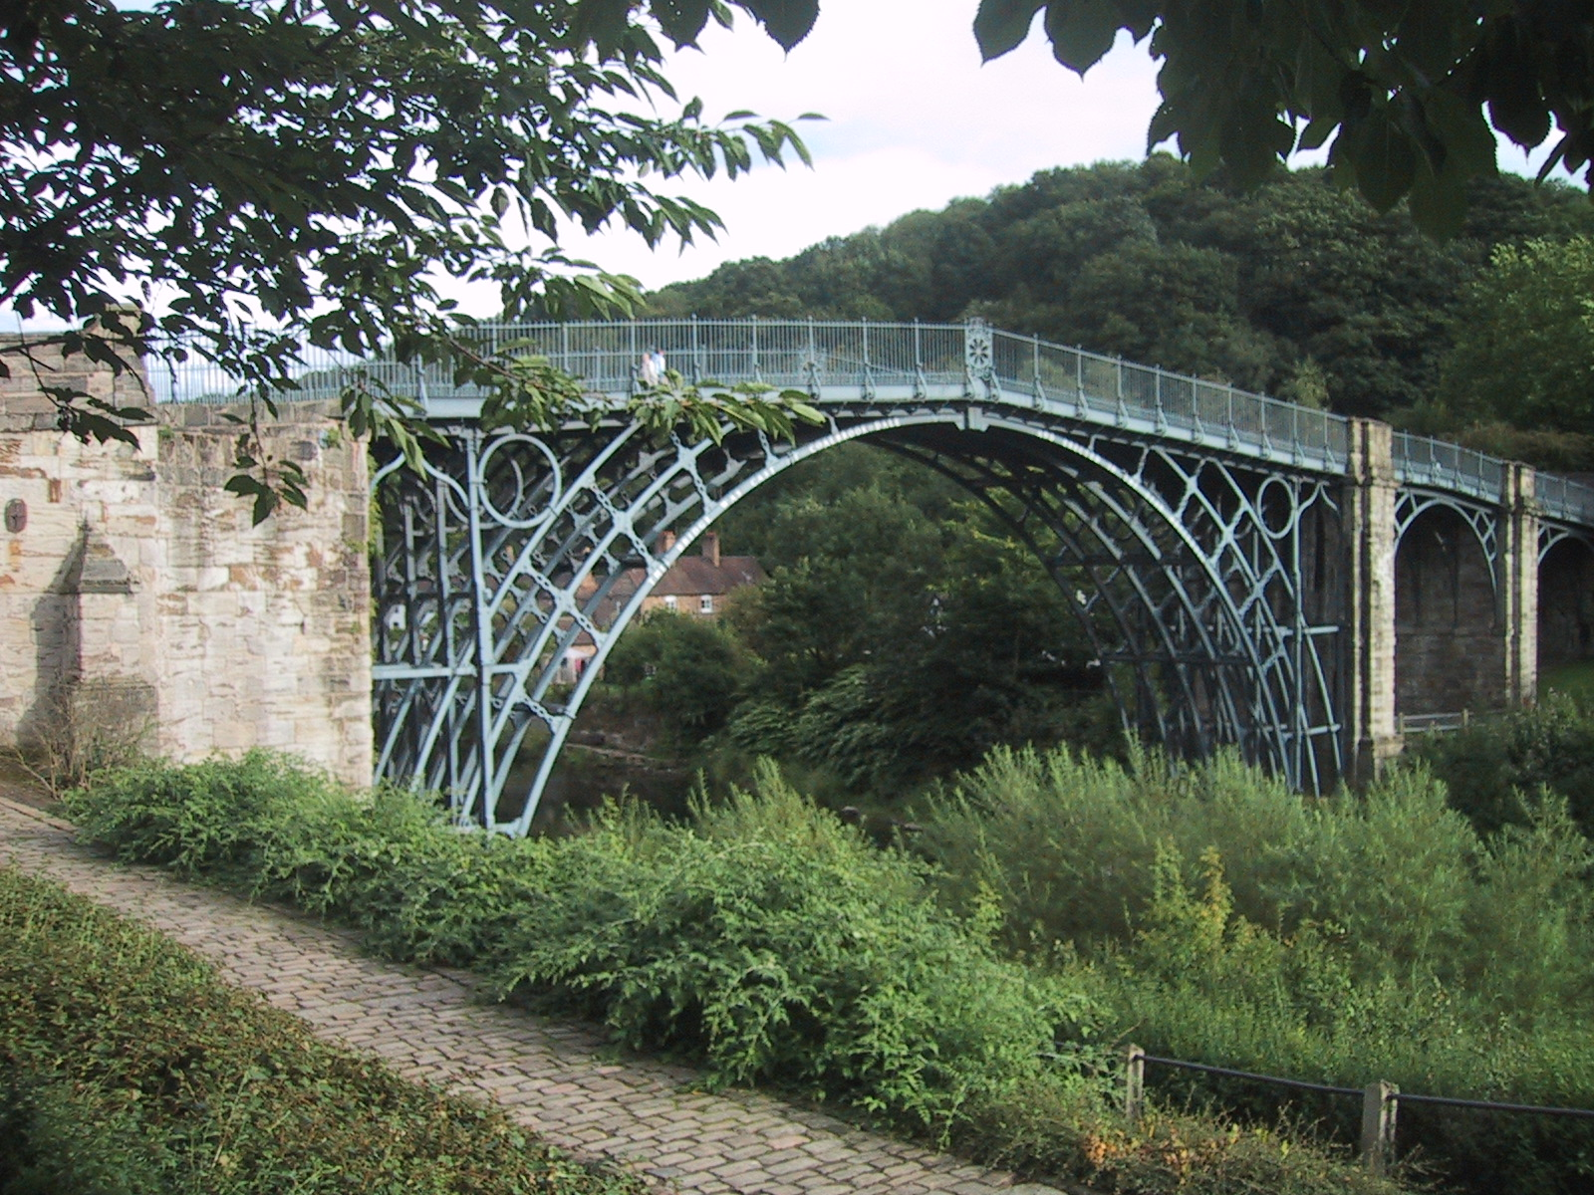
Iron Bridge the oldest iron bridge in the UK

Slide 7
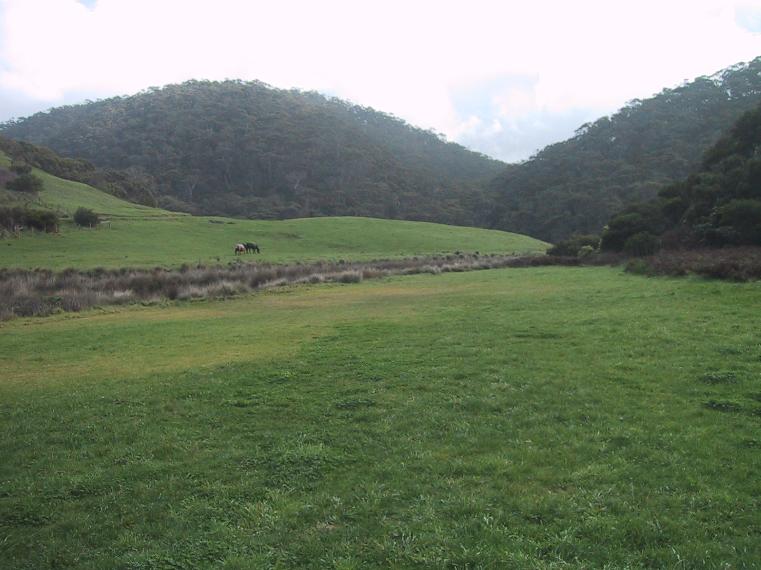
Otway Ranges, Australia (there was a sign here saying “No Camping”, but people still camped there. So the authorities put up a new sign saying “No Camping – Tiger Snakes”. Now no one camps there.)

Slide 8
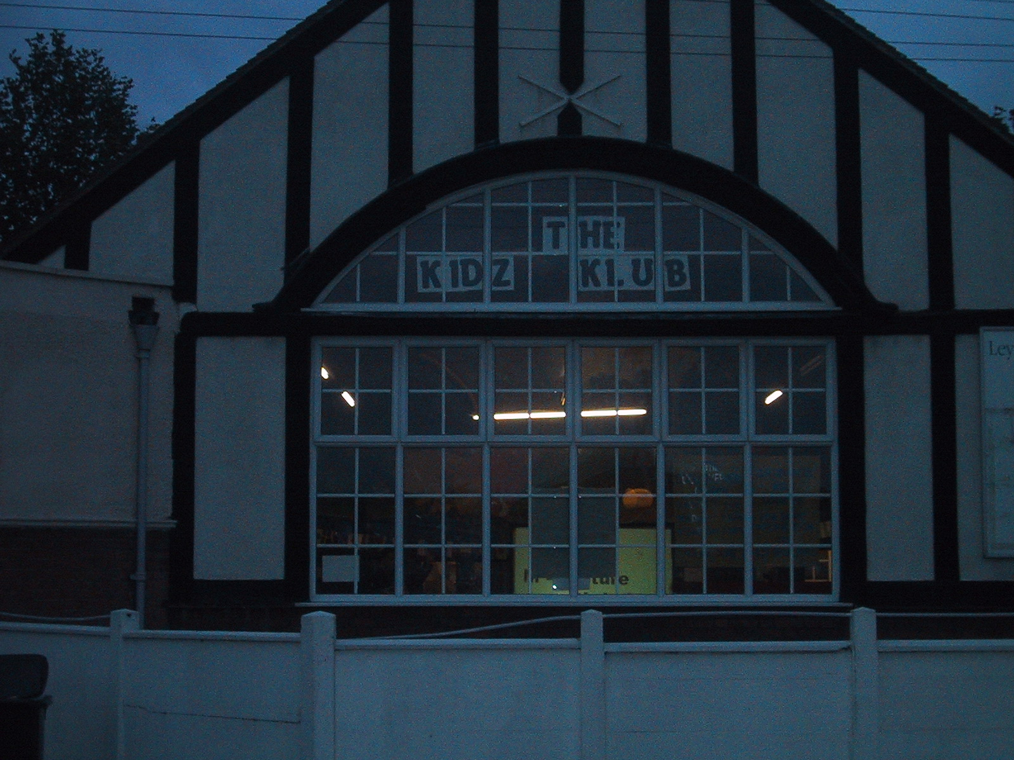
London, UK

Slide 9
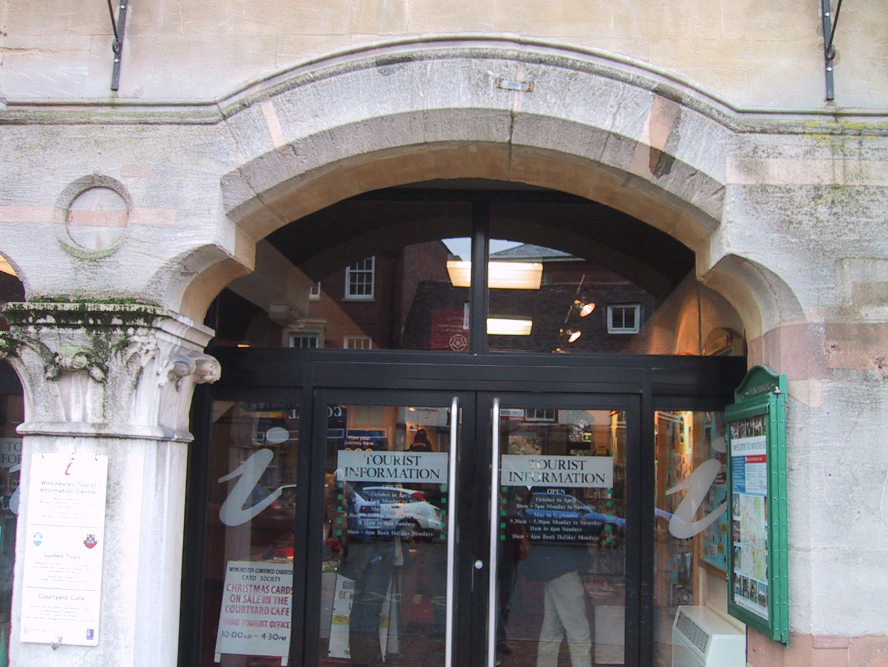
Winchester, UK

Slide 10
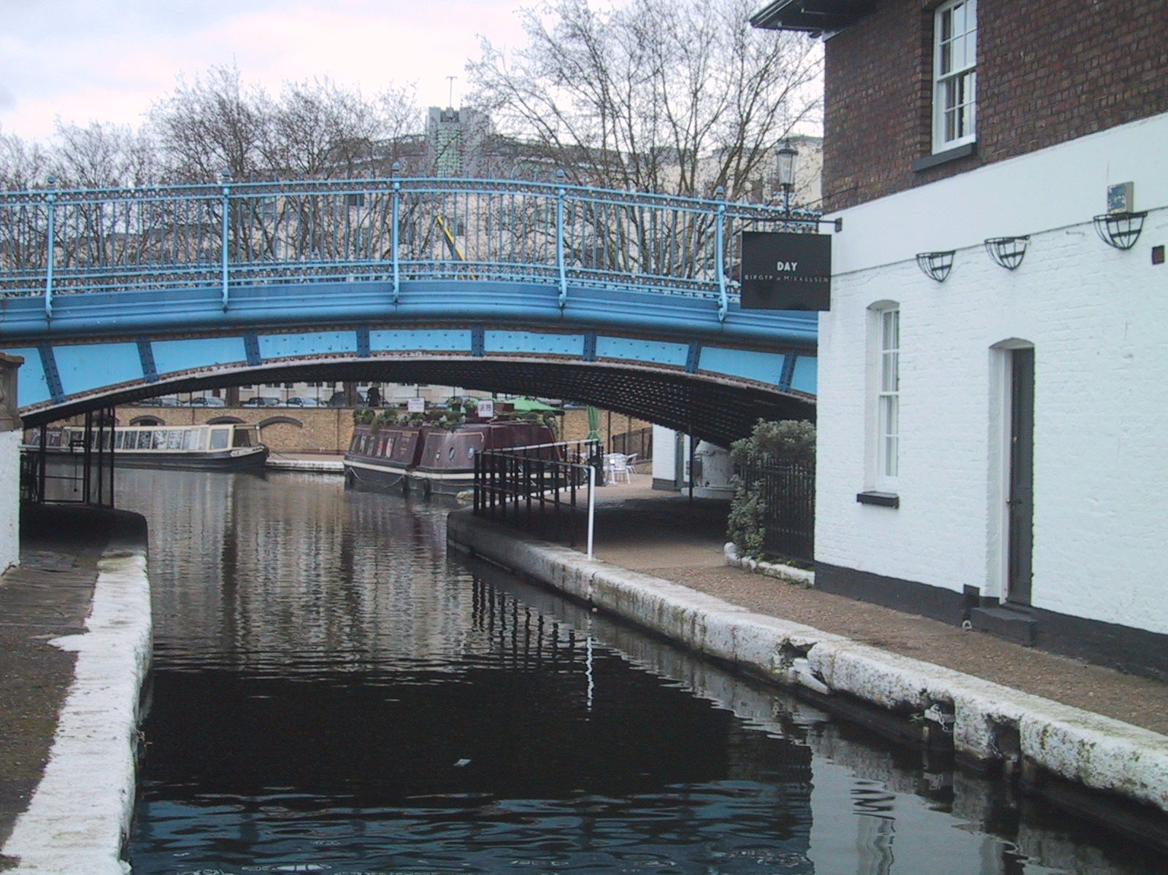
Bridge at the intersection of the Grand Canal & Regent’s Canal, London, UK

Slide 11
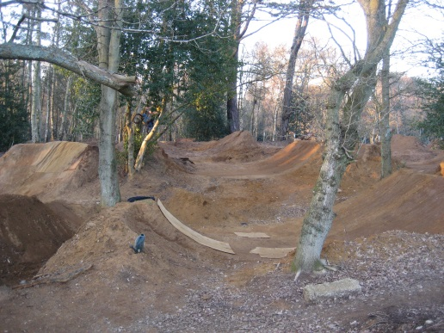
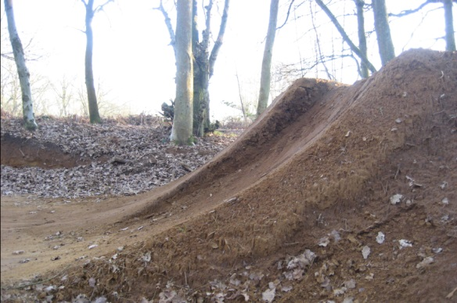
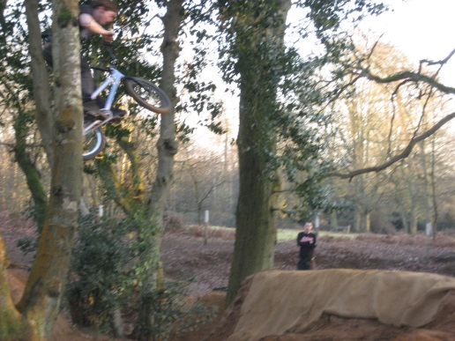
Back in Hampshire, UK, some very keen BMXs would build themselves ramps like this in the forest. …
… The local government would bulldoze down the ramps and they would come back with their shovels and rebuild them. Why …
… So they could fly through the trees. The local government eventually gave them the land to use
What is the equation of the curve in the middle photo?

Slide 12
Sheet Common, Hampshire, UK

Slide 13
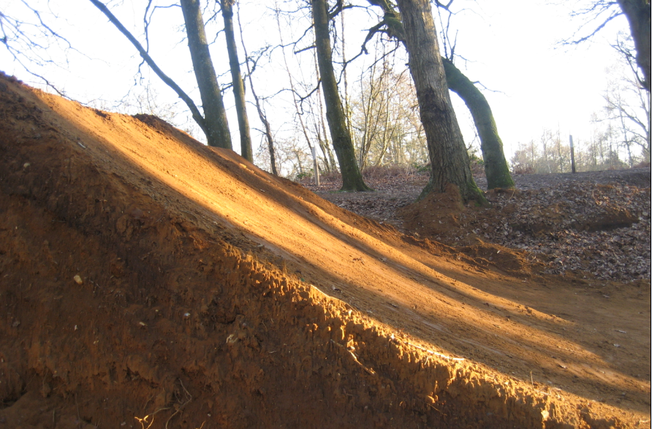
Sheet Common, Hampshire, UK

Slide 14
We will find the equations of these parabolas (using GSP or Autograph) later, but first we need to learn what happens when: we add to x²; subtract from x²; multiply x² by a whole number, fraction or negative; add and subtract numbers to x then square it; and a combination of these.

