Slide 1
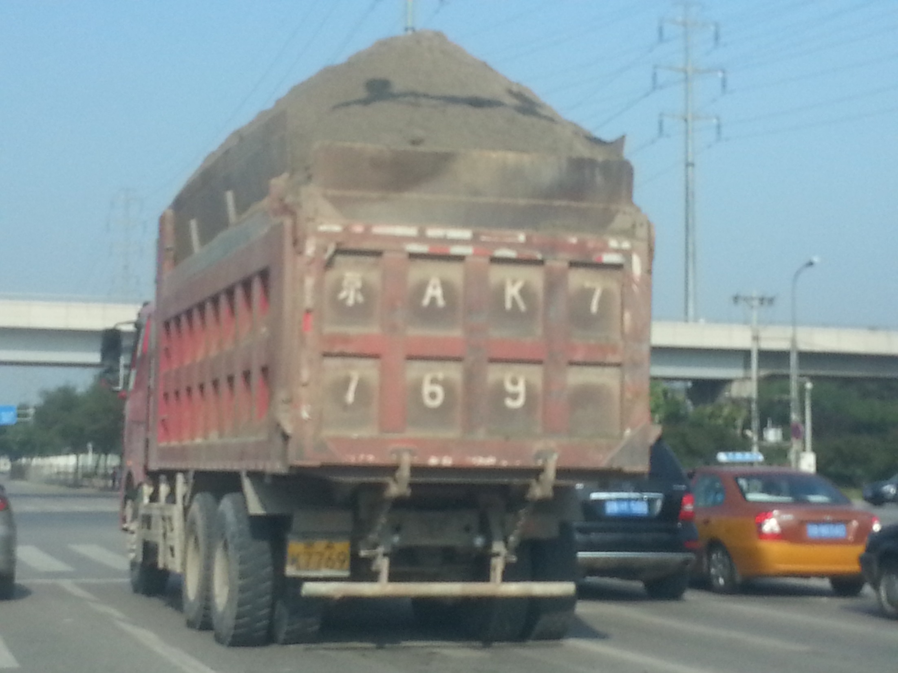
Tell me something mathematical about this photo.

Slide 2
The next section should promote lots of discussion amongst the students. Start them off in pairs.

Slide 3
Estimate the weight of the truck, the dirt and the truck & dirt together.

Slide 4
Note for the next sections the students may need access to some information to help them. Have resources at hand so that they can research the information they need.
However actual figures are not required to do the other questions as it is estimation and understanding percentages.

Slide 5
What are the actual weights of the truck, the dirt and the truck & dirt together.

Slide 6
Estimate the volume of the dirt.

Slide 7
When dirt is dug out of the ground it bulks (increases its volume by 30%. What was the original volume?

Slide 8
Other ideas for discussion
Fuel consumption
Tyre pressure
Weight on each wheel
Why doesn’t the dirt fall off the truck?

