Slide 1
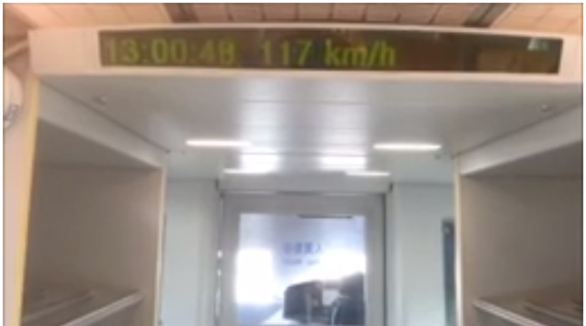
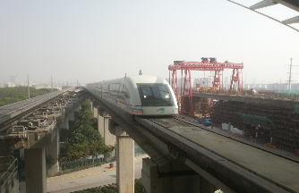

Slide 2
This is a video that shows the acceleration of the MagLev train in Shanghai, China. It is currently the fastest train in the world (it has been tested to 501km/hr, Wikipedia).
The video shows the speed of the train over time and hence makes a good maths investigation for speed, distance, time, velocity and acceleration with their respective graphs.
If you want ideas on this then please visit MrTaylorsMaths.weebly.com. Any comments or ideas on what could be included as ideas for the students to pursue then please email me mathsmethods@live.co.uk. Enjoy!
If the MagLev link above doesn’t work here is the YouTube link – https://www.youtube.com/watch?v=LbShmGYxXtY
The following two pages have some information about the MegLev that you may like to incorporate and after that there are some ideas to get the students thinking if they have trouble coming up with ideas.
If you wish to read Shanghai Maglev Train’s version of MagLev development then follow this link http://www.smtdc.com/en/gycf3.asp

Slide 3
Background
Transit type | Magnetic levitation
Number of lines | 1
Number of stations | 2
Operation
Began operation | January 1, 2004
Operator(s) | Shanghai Maglev Transportation Development Co., Ltd.
Technical
System length | 30.5 km (18.95 mi)
http://en.wikipedia.org/wiki/Shanghai_Maglev_Train

Slide 4
The Shanghai Maglev Train or Shanghai Transrapid (Chinese: 上海磁浮示范运营线; literally "Shanghai Maglev Demonstration Operation Line") is a magnetic levitation train, or maglev line that operates in Shanghai, China.
It is the first commercially operated high-speed magnetic levitation line in the world and only the third Maglev line to be operated. The train line was designed to connect Shanghai Pudong International Airport and the outskirts of central Pudong where passengers could interchange to the Shanghai Metro to continue their trip to the city centre.
Construction of the line began in 1 March 2001,^{[1]} and public commercial service commenced on 1 January 2004. The top operational commercial speed of this train is 431 km/h (268 mph), making it the world's fastest train in regular commercial service since its opening in 2004. During a non-commercial test run on 12 November 2003, a maglev train achieved a Chinese record speed of 501 km/h (311 mph).^{[2]}
It cost $1.2 billion to build.^{[3]} The train set was built by a joint venture of Siemens and ThyssenKrupp in Kassel. The track (guideway) was built by local Chinese companies who, as a result of the swampy soil conditions of the Pudong area, had to deviate from the original track design of one supporting column every 50 meters to one column every 25 meters, to ensure that the guideway meets the stability and precision criteria. Additionally, they had to inject several concrete piles to depths of up to 70 meters into the ground, to support the column foundations. A local facility to manufacture the guideway elements was installed next to the track area prior to construction.
The electrification of the train was developed by Vahle, Inc.^{[4]} Two commercial maglev systems predated the Shanghai system: the Birmingham Maglev in the United Kingdom and the Berlin M-Bahn. Both were low-speed operations and closed before the opening of the Shanghai Maglev Train.
The line is not a part of the Shanghai Metro network, which operates its own service to Pudong Airport from central Shanghai and from Longyang Road Station.
http://en.wikipedia.org/wiki/Shanghai_Maglev_Train

Slide 5
Run the video through once and ask the students write down what they notice.
If nothing comes forward you may have to lead the discussion eg –
What time elapsed?
What was the maximum speed?
When did the train reach 100 miles per hour (100 mph)?
How long do you think it would have taken for the train to reach the speed it was at when the video started?
What is the final speed in mph?
The track is 30.5kms. How long does the journey take?
What is the average speed?
How many m/s is the train going?
During the journey the return train passes the outgoing train. Each train is 153.6m long. How long does it take for the two trains to pass each other?

Slide 6
The train carries 574 passengers but is running at 20% capacity. How many people does it carry?
From the timetable below, work out how many passengers the train carries in one year.
Daytime hours^{[7]} | 06:45–08:45 | 09:00–10:45 | 11:00–14:45 | 15:00–15:45 | 16:00–19:00 | 19:00-21:40
Journey time (minutes) | 8:10 | 7:20 | 8:10 | 7:20 | 8:10 | 8:10
Maximum speed | 301 km/h (187 mph) | 431 km/h (268 mph) | 301 km/h (187 mph) | 431 km/h (268 mph) | 301 km/h (187 mph) | 301 km/h (187 mph)
Average speed | 224 km/h (139 mph) | 251 km/h (156 mph) | 224 km/h (139 mph) | 251 km/h (156 mph) | 224 km/h (139 mph) | 224 km/h (139 mph)h
Interval | 15 minutes | 15 minutes | 15 minutes | 15 minutes | 15 minutes | 20 minutes

Slide 7
Use the video to draw a graph of velocity-against-time.
Try to complete this for the whole journey? What assumptions will you have to make?
The gradient of the velocity-time-graph gives you ……………………………… .
The area under the graph gives you …………………………………. .
Draw a distance-time-graph for the journey.
The gradient of the distance-time-graph gives you ……………………………… .
The area under the graph gives you …………………………………. .

Slide 8
Some More information that you might like to include - Wikipedia
The line is operated by Shanghai Maglev Transportation Development Co., Ltd and runs from 06:45 to 21:30, with services every 15 to 20 minutes. A one-way ticket costs ¥50 (US$7.27), or ¥40 ($5.81) for those passengers holding a receipt or proof of an airline ticket purchase. A round-trip return ticket costs ¥80 ($11.63) and VIP tickets cost double the standard fare.
Following the opening, overall maglev train ridership levels were at 20% of capacity.^{[6]} The levels were attributed to limited operating hours, the short length of the line, high ticket prices and that it "virtually goes nowhere", terminating at Longyang Road in Pudong – another 20 min by subway from the city centre.^{[6]}
Daytime hours^{[7]} | 06:45–08:45 | 09:00–10:45 | 11:00–14:45 | 15:00–15:45 | 16:00–19:00 | 19:00-21:40
Journey time (minutes) | 8:10 | 7:20 | 8:10 | 7:20 | 8:10 | 8:10
Maximum speed | 301 km/h (187 mph) | 431 km/h (268 mph) | 301 km/h (187 mph) | 431 km/h (268 mph) | 301 km/h (187 mph) | 301 km/h (187 mph)
Average speed | 224 km/h (139 mph) | 251 km/h (156 mph) | 224 km/h (139 mph) | 251 km/h (156 mph) | 224 km/h (139 mph) | 224 km/h (139 mph)h
Interval | 15 minutes | 15 minutes | 15 minutes | 15 minutes | 15 minutes | 20 minutes

Slide 9
The line runs from Longyang Road station in Pudong to Pudong International Airport; The Pudong International Airport station provides a transfer to Line 2, but the Longyang Road station provides access to Line 2 and Line 7.
At full speed, the journey takes 7 minutes and 20 seconds to complete the distance of 30.5 km (18.6 mi), although some trains in the early morning and late afternoon take about 50 seconds longer. A train can reach 350 km/h (217 mph) in 2 minutes, with the maximum normal operation speed of 431 km/h (268 mph) reached thereafter.
Maglev Vehicle Data The Trains in Shanghai are of the Transrapid SMT type which is based on the German TR 08.
Number of vehicles/trains: 3
Sections: 6 each train
Length: 153.6 m
Width: 3.7 m
Height: 4.2 m
Maximum operating speed: 505 km/h
Total Passenger capacity: 574
End section (ES) 1st class: 56
Middle section (MS) 2nd class: 110
End section (ES) 2nd class: 78

