Slide 1
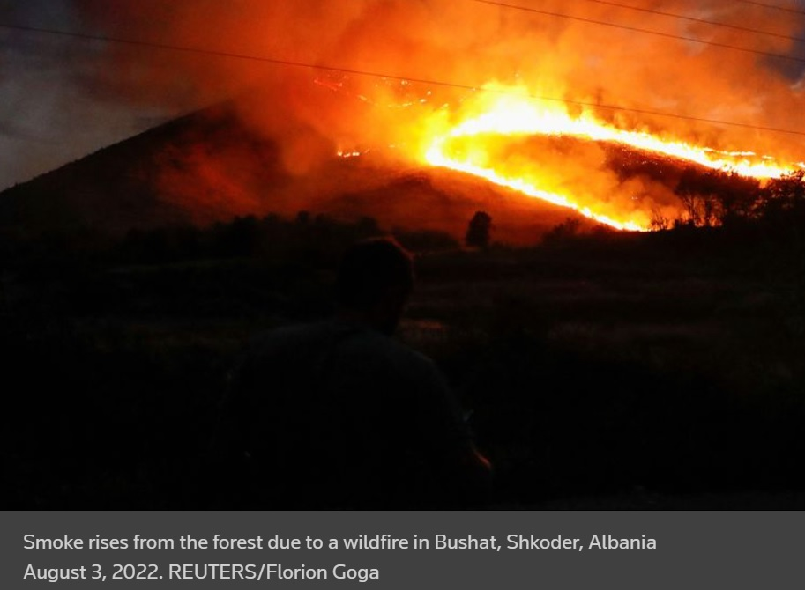

Slide 2
Using Loci, In This Case Bearings, To Locate Forest Fires

Slide 3
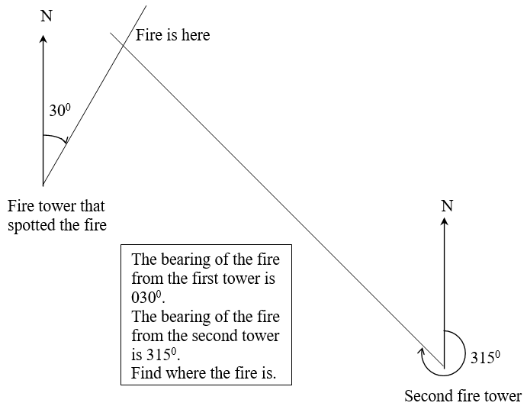
In Australia there is always a threat of bush fires. So through out the forest there are fire towers that rise above the trees, on the tops of hills, so that a person sitting in them can spot smoke and alert the fire authorities that a fire is about to break out.
But the fire needs to be pinpointed. The person that spots the fire would take a bearing from his tower to the fire and draw a line on his map. In the example this is $30°$.
A second fire tower gives the bearing of the fire from his tower and in this example it is 315⁰.
Both bearings are drawn onto the one map and where the lines cross is where the fire is.
The same can be done to locate ships off a coast that is in trouble. If 2 people know exactly where they are on the map they can locate a position of a ship if they are able to give bearings to the ship from where they are.

Slide 4
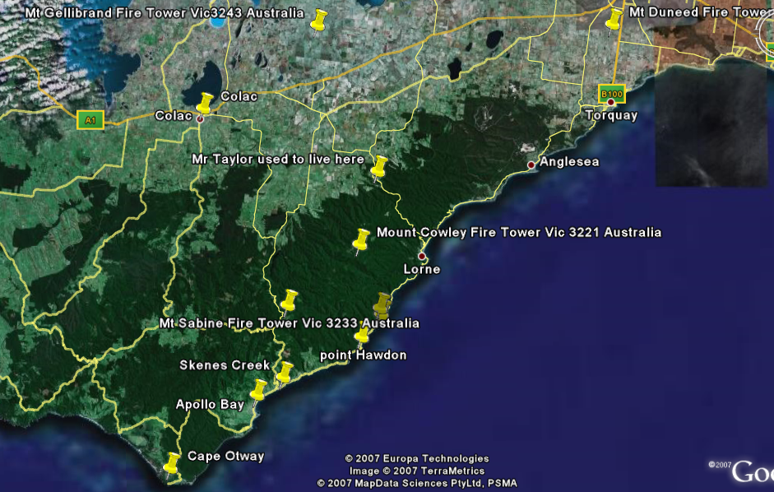
N
Lake

Slide 5
Find the Fire Using These Bearings
It’s a terrible hot summer with scorching north winds blowing from the centre of Australia which pushes temperatures into the 40⁰C range in the Victoria and in the Otway Ranges. Fire towers are erected in the Otways for spotting fires. These fire towers are spotting fires on a daily basis. Find out where the fires are.
Using Google Maps, locate these fire towers using their coordinates and then print it off.
Mount Duneed Latitude -38 14 31 Longitude 144 18 51
Mount Cowley Latitude -38 32 56 Longitude 143 51 29
Mount Sabine Latitude -38 37 33 Longitude 143 43 39
Mount Gellibrand Latitude -38 14 12 Longitude 143 47 25

Slide 6
Use the map, of the Otways, on slide 4, or the map you printed off to locate the fire towers, use the given bearings to locate the fires.
Monday
Mt Sabine spots a fire on a bearing of 010⁰. Mt Cowley spots a fire on a bearing of 355^{0.}
Tuesday
Mt Duneed spots a fire on a bearing of 260⁰. Mt Cowley spots a fire on a bearing of 290^{0.}

Slide 7
Wednesday
Mt Duneed spots a fire on a bearing of 222⁰. Mt Cowley spots a fire on a bearing of East.
Thursday
Mt Sabine spots a fire on a bearing of 310⁰. Mt Gellibrand spots a fire on a bearing of 230^{0.}
Friday
Mt Duneed spots a fire on a bearing of 232⁰. Mt Cowley spots a fire on a bearing of 044^{0.}
Saturday
Mt Sabine spots a fire on a bearing of 215⁰. Mt Gellibrand spots a fire on a bearing of 195^{0.}

Slide 8
Sunday
Mt Gellibrand spots a fire on a bearing of Southwest. Mt Cowley spots a fire on a bearing of West.
Monday
Mt Sabine spots a fire on a bearing of 031⁰. Mt Cowley spots a fire on a bearing of 015^{0.}
Tuesday
Mt Gellibrand spots a fire on a bearing of 270⁰. Mt Duneed spots a fire on a bearing of West.
Wednesday
Make up one of your own ensure it works & give it to your partner

