Slide 1
Chapter 4 –
Logarithms
The Questions in this revision are taken from the book so you will be able to find the answers in there.

Slide 2
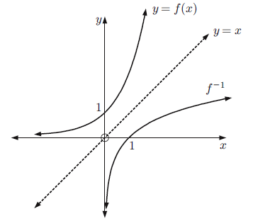
Chapter 4 – Part A
I can do or understand this
graph
Remember the inverse of a function is a reflection of the function in y = x.
Remember log$10$ x is the same as log x. So if you see a log without a base given then it log base 10 (log$10$).
What is the domain and range of f(x)?
What is the domain and range of f⁻¹(x)?
Note & understand 10^{log a} = a
log$10$ 10ª = a
log$10$ 10 = 1
v
v
v
v
v

Slide 3
Chapter 4 – Part A
See example 1
See example 2
See example 3
See example 4
I can do or understand this
v
v

Slide 4
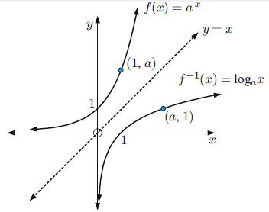
Chapter 4 – Part B Looks at logarithms with different bases.
See example 5
See example 6 – Hint: get all numbers as single exponents with the base the same as the log.
I can do or understand this
Note & understand a ^{log}$a$ ^{x} = x
log$a$ a^{x} = a
log$a$ a = 1
fix
v
v
v
v
v

Slide 5
Chapter 4 – Part B
Chapter 4 – Part C. They are in the formula booklet but know how to use them.
Note: 1 = log_{a} a 2 = 2log_{a} a = log_{a} a² 3 = 3log_{a} a = log_{a} a³ q = qlog_{a} a = log_{a} a^{q}
See examples 7 & 8. Sometimes you can express the number as an exponent with the same base as the log, e.g. log₇ 49 = log₇ 7² = 2 log₇ 7 = 2.
I can do or understand this
v
v
v
v
v
v
Same base
v
v
v
v
v
v
v
v

Slide 6
Chapter 4 – Part C. Laws of Logs cont.
Hint: Form exponents with the same base, then apply index laws to simplify.
See example 9
I can do or understand this
v
v
0.2 = 0.222222222222… If you put 0.22222222… into your calculator 15+ time and press = then it gives it to you as a fraction. This works for most recurring decimals. For the graphics calculator use the fraction button.

Slide 7
Chapter 4 – Part C.2. This is about changing equations into logarithmic equations and logarithmic equations into standard equations.
See example 10 & 11.
I can do or understand this
v
v

Slide 8
Chapter 4 – Part D. Make sure you understand every point that is made below.
I can do or understand this
graph
v
v
v
v
v
v

Slide 9
Chapter 4 – Part D.1
See example 12
See example 13
I can do or understand this
Hint: get all numbers as single exponents with the base the same as the log.
Hint: get all the exponents in this form ln(f(x)) – a natural of a function.
Hint: get all numbers as single exponents with the base the same as the log.

Slide 10
Chapter 4 – Part D.2
See examples 14, 15 & 16
See example 17
I can do or understand this
v
v
v
v
v
v
v
v

Slide 11
Chapter 4 – Part E. If you cannot express the exponentials on both sides of an equation with the same base then you can solve using logs to find an exact value.
Notice in example 18, 30 cannot be expressed as an exponential with base 2. So we “take logs” to both sides of the equation and then solve. Also see example 19.
See example 20. Remember when rearranging swap the two letters and then rearrange to get the original letter that was the subject of the equation by itself.
See example 21. With any equations where you have to solve for x, get x by itself.
I can do or understand this
v
Hint: Get the exponential by itself then take logs of both sides to the same base as the exponent.
Hint: Get all the exponents to one side, simplify or form a quadratic then solve for x
Hint: Since the graphs intersect they share the same y, therefore equate the two equations and solve for x, then find the y value. Write the answer as a set of coordinates.

Slide 12
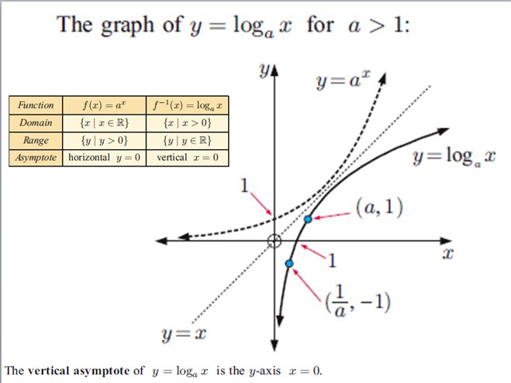
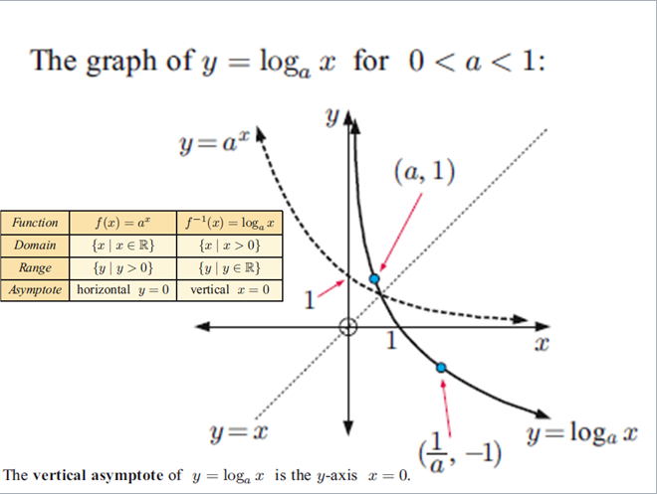
Chapter 4 – Part F. Once upon a time slide rules and calculators only calculated logs in the base of 10, so you had to be able to change logs that weren’t in base 10 into base 10. Today calculators can work in other bases, but the skill is still necessary as in example 23 when you may need to give an exact answer.
Remember that a function reflected in y=x is an inverse of the original function. Also the domain of the original is the range of the inverse and the range of the original is the domain of the inverse.
I can do or understand this
v
v

Slide 13
Chapter 4 – Part G cont.
See examples 24 & 25
I can do or understand this
v
v

Slide 14
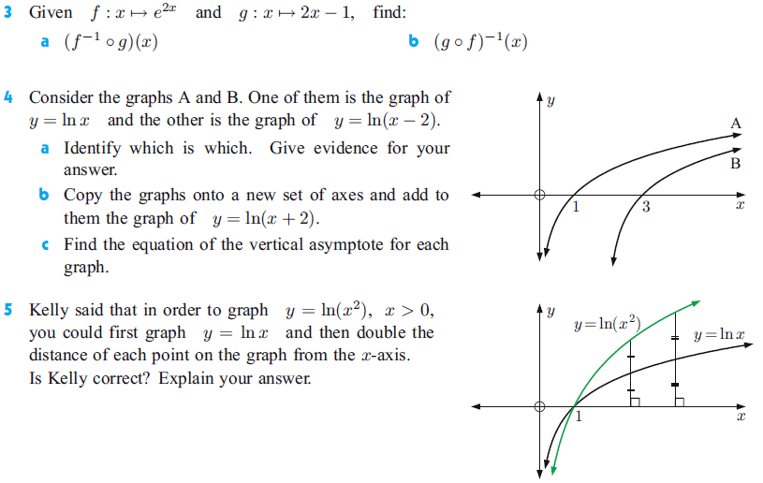
Chapter 4 – Part A
I can do or understand this
v

Slide 15
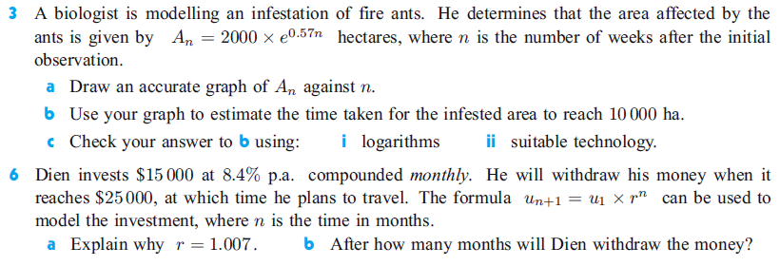
Chapter 4 – Part H. Logs can be used to solve exponential problems that occur due to growth & decay. See examples 26 & 27
I can do or understand this
v
v

